Slide 1
Python Introduction

Slide 2

Basic variables
Notes:
No need to specify data type in Python.

Slide 3
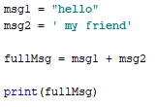
String concatenation
Result:
hello my friend
Notes:
You can concatenate strings using the “+” operator

Slide 4

Dictionary
Result:
cool
Notes:
Dictionaries in python are like maps in java or c++. You can use any Hashable data type as the key and any data type as the value

Slide 5

Lists
Result:
1
Result:
1
start
end
step

Slide 6

Lists cont.
Result:
[‘welcome’ , 9]
Result:
Welcome

Slide 7

Tuples
Result:
[123,3]
Notes:
Similar to list

Slide 8

If statement

Slide 9

While loop

Slide 10

For loop

Slide 11
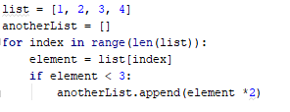
List comprehension

Slide 12
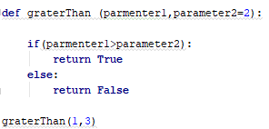
Functions
Notes:
def [functionName] ([parameter1] , [paramter2] … [parameterN]=[default value]):
// someCode
return [some value]

Slide 13


Vectorized code
Why vectorized code?
Much faster
Elegant and concise
Notes:
On CPU the speed up is almost 20x
On GPU the speed up could reach 150x

Slide 14
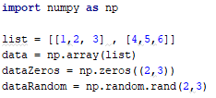
Vectorized code cont.

Slide 15
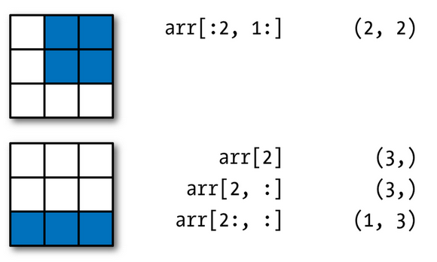
Vectorized code Indexing

Slide 16
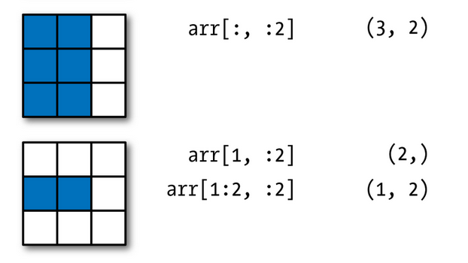
Vectorized code Indexing

Slide 17

Boolean Indexing
Result:
[1,2,5,6]

Slide 18

Boolean Indexing cont.
Result:
[[1,2,3]]

Slide 19

Boolean Indexing cont.
Result:
[[1,3] ,
[4,6] ]

Slide 20

Boolean Indexing cont.
Result:
[3,4,5,6]

Slide 21
Numpy operations
Matrix operator Matrix
Matrix operator Vector
Matrix operator Scaler

Slide 22

Matrix operator Matrix
A
B
C
1 | 2 | 3
4 | 5 | 6
7 | 8 | 9
10 | 11 | 12
1+7 | 2+8 | 3+9
4+10 | 5+11 | 6+12

Slide 23

Matrix operator Vector
A
B
C
1 | 2 | 3
4 | 5 | 6
7
8
1+7 | 2+7 | 3+7
4+8 | 5+8 | 6+8
Notes:
What happens when adding matrix to vector is called broadcasting

Slide 24

Matrix operator Scaler
A
B
C
1 | 2 | 3
4 | 5 | 6
1+5 | 2+5 | 3+5
4+5 | 5+5 | 6+5
5

Slide 25

Numpy functions examples
A
Axis =1
C
Axis =0
B
1 | 2 | 3
4 | 5 | 6
6
15
5 | 7 | 9

Slide 26
Numpy functions examples
Result:
numbers = [6, 9, 15]
numbersCount = [1 , 2 , 3]

Slide 27
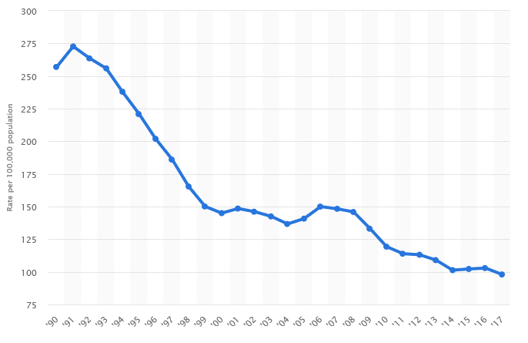
Data Visualization
Why visualization
Understand data distribution
Illustrate things for non technical people

Slide 28
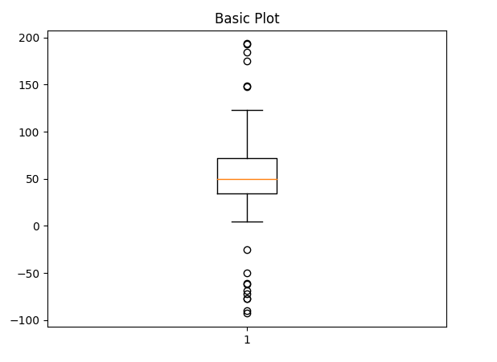

Box Plot

Slide 29
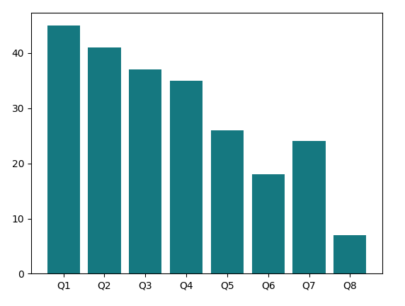

Bar plot

Slide 30
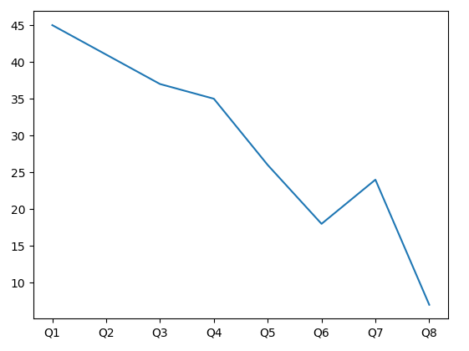

Line plot

Slide 31
